Slide 1
CEIS295 Module 1
Speed Test for ArrayList Data Structure

Slide 2
Rubric
Activity | Requirement(s) | Points
Develop Code to Test Algorithm’s Real-World Speed | TimeProcess.py Code | 6
Develop Code to Use Objects with the ArrayList | Client.py Code | 6
Develop Code to Test Algorithm Speed | ArrayListActualSpeed.py code | 6
Screenshot to Demonstrate Working Application | Screenshot of running application showing your name and the current date | 6
Excel Table Showing Relevant Speeds | Table showing amount of time for each process | 6

Slide 3
TimeProcess.py Python Code
Code:#Name: Blake Reidinger
#Date: 10/26/23
import time # use time library to time the code executions
# get current time before the process
start_time = time.time()
# run the process
for i in range(1000):
print( "Hello Everyone!" )
# get current time after the process
end_time = time.time()
# subtract start time from end time to get time used by process
total_time = end_time - start_time
# Show the result. Note: .6f means “show six decimal places”
print("\nSeconds run 1000 times: {:.6f}".format(total_time))
Paste your TimeProcess.py Python code.
Include the following processes:
Test the following process speed:
Display “Hello Everyone” one thousand times

Slide 4
Client.py Python Code
Code:#Blake Reidinger
#Date 10/23/2023
class Client:
def __init__(self, client_id=0, first_name="Unknown",
last_name="Unknown", phone="Unknown", email="Unknown"):
"""Initialize Atrributes"""
self.__client_id = client_id
self.__first_name = first_name
self.__last_name = last_name
self.__phone = phone
self.__email = email
#Classes that compare objects must implement __eq__ and __lt__ methods
#__lt__ means "less than and it must return a boolean
# __eq__ means "equals" and it must retrun a boolean
def __lt__(self, other):
return self.__client_id < other.__client_id
def __eq__(self, other):
return self.__client_id == other.__client_id
#__str__() method is automatically called when you print the object
def __str__(self):
return str(self.__client_id) + ", " + self.__last_name + "," + self.__first_name
#getters and setters
def get_client_id(self):
return self.__client_id
def set_client_id(self, client_id):
self.__client_id = client_id
def get_first_name(self):
return self.__first_name
def set_first_name(self, first_name):
self.__first_name = first_name
def get_last_name(self):
return self.__last_name
def set_last_name(self, last_name):
self.__last_name = last_name
def get_phone(self):
return self.__phone
def set_phone(self, phone):
self.__phone = phone
def get_email(self):
return self.__email
def set_email(self, email):
self.__email = email
Paste your Client.py Python code in the box on the right side.
Include the following attributes and behaviors:
Attributes
__client_id
__first_name
__last_name
__phone
__email
Behaviors
__eq__
__str__
Getters and Setters

Slide 5
ArrayListActualSpeed.py Python Code
Code:#Blake Reidinger
# Date 10/26/2023
from ArrayList import ArrayList
from Client import Client
from Quicksort import Quicksort
from datetime import date
import time #Use this libary to time the code executions
import random # Use to generate random numbers
import sys # use to terminate the application early
# Display name and date in output
print("Name:", "Rick Bird")
print("Date:", date.today())
print()
#Create a list
clients = []
input_file_name = 'ClientData.csv'
with open(input_file_name) as infile:
for line in infile:
#split the line based on the commas
s = line.split(',')
client_id = int( s[0] ) #Convert the default string to an integer
f_name = s[1]
l_name = s[2]
phone = s[3]
email = s[4]
#Create a client object using data from the file
clt = Client(client_id, f_name, l_name, phone, email)
#Add the client object to the list
clients.append(clt)
#Sort the clients list
Quicksort.sort(clients)
#How many client objects do we have?
num_records = len(clients)
#Create an ArrayList object
my_array_list = ArrayList()
# Scenario 1: Printer Queue or Call Queue
section_title = "Scenario: Printer Queue or Call Queue"
print(section_title)
print("-" * len(section_title))
#How long does it take to add the client recrods to the ArrayList?
start_time = time.time()
for i in range(num_records):
my_array_list.append(clients[i])
end_time = time.time()
total_time = end_time - start_time
print("Seconds to add records: {:.6f}".format(total_time))
#How long does it take to remove records from the front of the ArrayList?
start_time = time.time()
for i in range(num_records):
my_array_list.remove_at(0)
end_time= time.time()
total_time = end_time - start_time
print("Seconds to remove records from front: {}".format(total_time))
# Scenario 2: Customer Service Center
answer = input("Continue (y/n)? ")
if answer.lower() != "y":
sys.exit() #End application
section_title = "Scenario: Customer Service"
print(section_title)
print("-" * len(section_title))
# add clients to the ArrayList
for i in range(num_records):
my_array_list.append(clients[i])
#How long does it take to randomly display 1000 records?
start_time = time.time()
for i in range(1000):
smallest_id = 100001
largest_id = smallest_id + num_records
random_num = random.randint(smallest_id, largest_id)
#print( my_array_list.search(Client(random_num)))
print( my_array_list.search_sorted(Client(random_num)))
end_time = time.time()
total_time = end_time - start_time
print("Seconds to display random records: {:.6f}".format(total_time))
# Scenario 3: Call Center
answer = input("Continiue (y/n)? ")
if answer.lower() != "y":
sys.exit() #End application
section_title = "Scenario: Call Center"
print(section_title)
print("-" * len(section_title))
#How long does it take to add records, randomly display 1000 records
# and randomly remove 1000 records?
start_time = time.time()
# add records
current_id = 100001 + num_records + 1
for i in range(1000):
my_array_list.append(Client(current_id))
current_id += 1
#Display random records
for i in range(1000):
smallest_id = 100001
largest_id = smallest_id + num_records
random_num = random.randint(smallest_id, largest_id)
#print( my_array_list.search(Client(random_num)))
print( my_array_list.search_sorted(Client(random_num)))
#Remove randm records
for i in range(1000):
smallest_id = 100001
largest_id = smallest_id + num_records
random_num = random.randint(smallest_id, largest_id)
print( my_array_list.search(Client(random_num)))
end_time = time.time()
total_time = end_time - start_time
print("Seconds to add, display, and remove records: {:.6f}".format(total_time))
Paste your Python code. Include the following processes:
Read records into application
Test the following process speeds:
Add records to beginning of data structure
Add records to end of data structure
Add records to middle of data structure
Retrieve records from beginning of data structure
Retrieve records from end of data structure
Retrieve records from middle of data structure

Slide 6
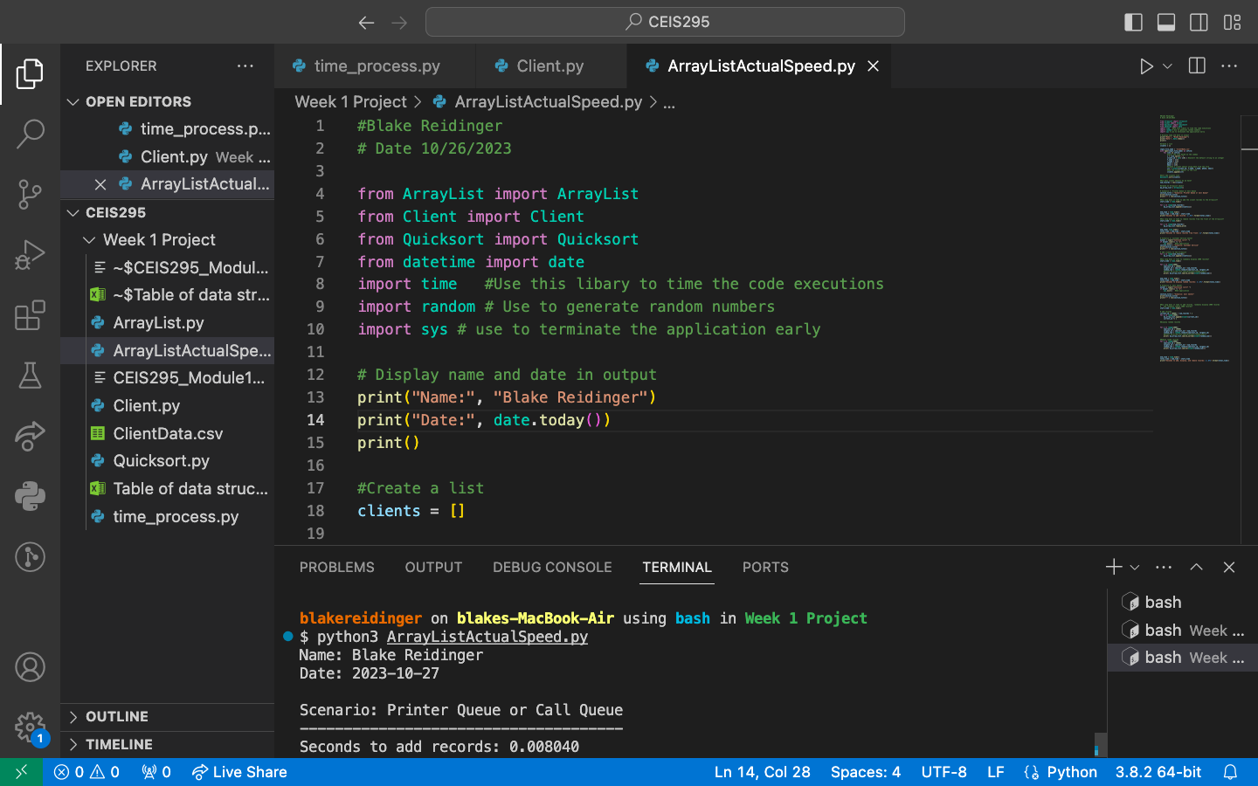

Slide 7
Table of Real - World speeds
 | ArrayList(Unsorted) | ArrayList(sorted data)
Scenario: Printer Queue or Call Queue or Service Queue
Add many records to end of data structure | 0.007257 | 0.010625
Pull all records off front of data structure | 10.006087 | 10.596607
Scenario: Customer Service Center
Display random records | 2.553499 | 0.033087
Scenario: Call Center
Add some records, display random records, remove random records | 4.843064 | 3.802457

